Slide 1
Animal Kingdom
the animal kingdom contains many phyla

Slide 2
Animals- some of these phyla and also some of the class of the two phyla
Those with backbones are called vertebrates and those without are invertebrates
Phylum Vertebrates :
class Fish – class Amphibians – class Reptiles – class Birds – class Mammals
Phylum arthropods :
Class Insects / Class Crustaceans / Class Arachnids / Class Myriapods
*** phyla of nematodes, molluscs and annelids

Slide 3
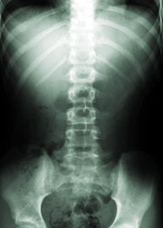
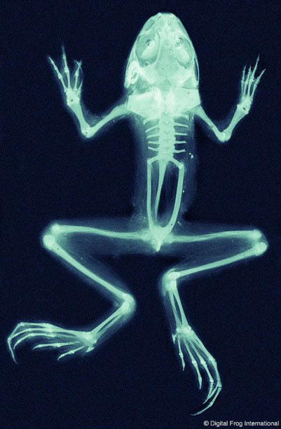
Vertebrates
These are animals with a backbone.
There are five groups of vertebrates:
  Amphibians
  Birds
  Fish
  Mammals
  Reptiles

Slide 4
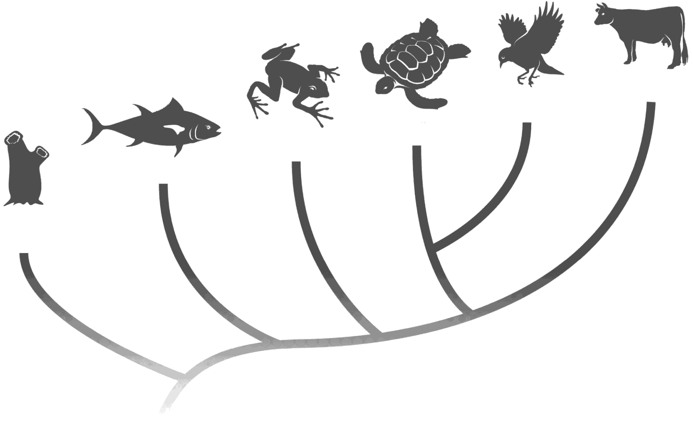
Animals
Section 30-1
Mammals
Birds
Reptiles
Amphibians
Fishes
Invertebrate
Animals with supporting rods running along the length of the body
The most familiar ones have a backbone and called vertebrates
And others do not have it so it is invertebrate

Slide 5
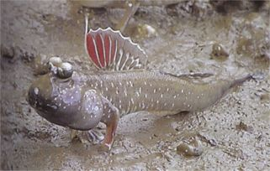
Class Fish – Facts
mudskipper
Fish are aquatic vertebrates – lives in water except for one or two like the mudskipper can spend short period of time breathing air .
characterized by streamlined body with fins ( pelvic , anal , pectoral , caudal and dorsal fins) for movement and strengthened by skeletal rays and do not contain muscle.
scaly skin – overlapping , cold blooded .
Gills and the heart contains 2 chambers.
Fish bring in Oxygen rich water through gills and remove oxygen poor water through gill slits.
Operculum covers the gills on either side of the body draws water across its gills
most of them - Good sense of smell and large eyes .
Most are egg laying without shells
Lateral lines – detect movements in water

Slide 6
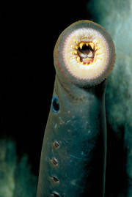
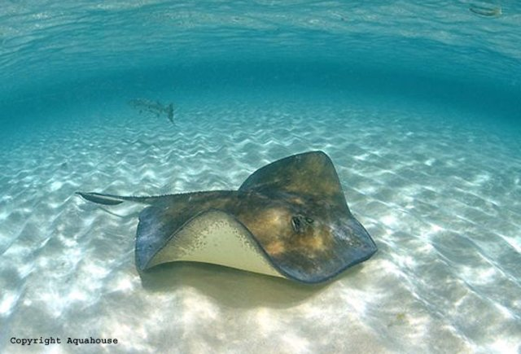
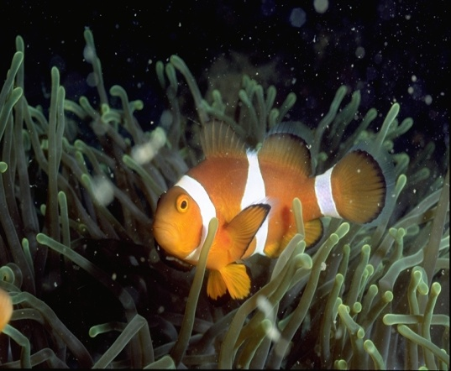
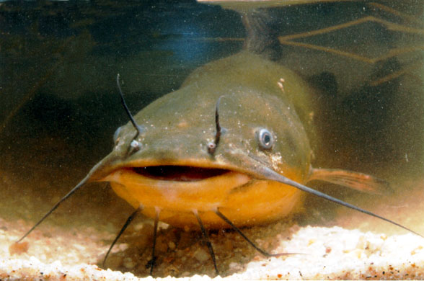
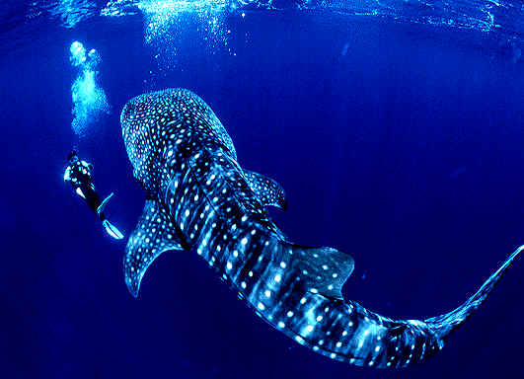
Sea Ray
Jawless Fish
Catfish
Whale Shark

Slide 7
Amphibians – Basic Facts
vertebrates Lives in both water and land but most adult lives in land and go back to water to breed
Most larvae are fishlike (tadpole) lives in water; adults are carnivores lives in land .
Larvae respire through gills; Adults use lungs and through skin.
moist ,scale-less skin .
External fertilization , eggs without shells.
Allow their body temperature to vary with environment
Heart 3 chambers

Slide 8
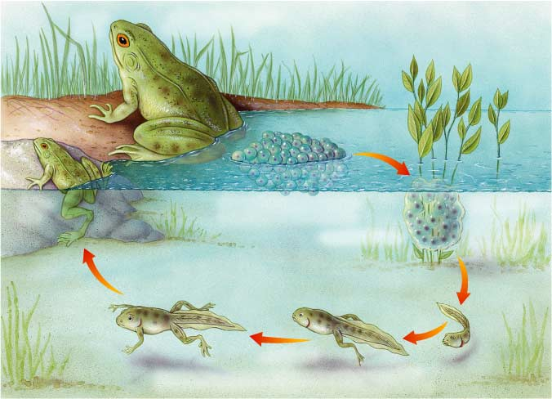
Section 30-3
The Life Cycle of a Frog
metamorphosis
Adult Frog
Adults are typically ready to
breed in about one to two years.
Young Frog
The eggs hatch into tadpoles a few days to several weeks later.
Fertilized Eggs
Frog eggs are laid in water and
undergo external fertilization.
Tadpoles
Tadpoles gradually grow limbs, lose their tails and gills, and
become meat-eaters as they develop into terrestrial adults.

Slide 9
Section 30-3
Amphibians
means
“Double life”
as
larvæ they live in
adults they live on
Water
Land
and have special adaptations such as
Bones
Lungs
Ribs
are
that allow for
that allow
that provide
Efficient
movement
Breathing
air
Support and
protection
are

Slide 10
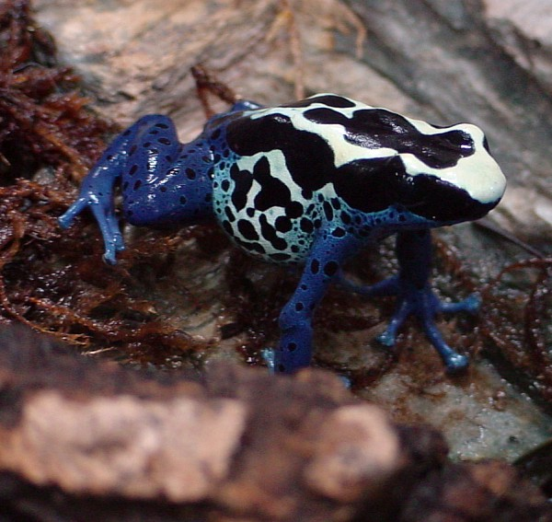
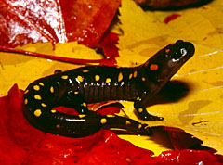
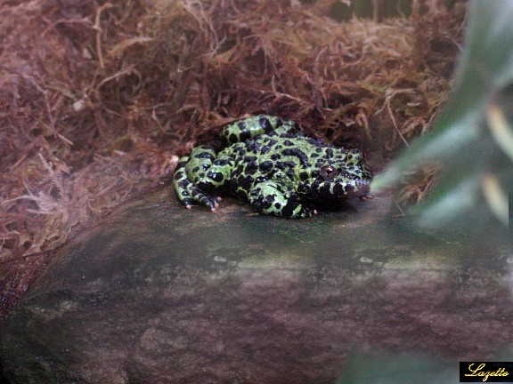
Spotted Salamander
Poison Dart Frog
Toad

Slide 11
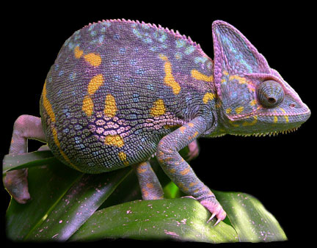
Reptiles – Basic Facts
vertebrates with Dry, scaly skin – helps prevent loss of body water in dry environments
  Internal Fertilization; Most are egg-laying … rubbery eggs : develop eggs that do not need to be deposited in water , because the eggs have waterproof shell which stops them from drying out
Allow their body temperature to vary with environment .
Heart 4chambers

Slide 12
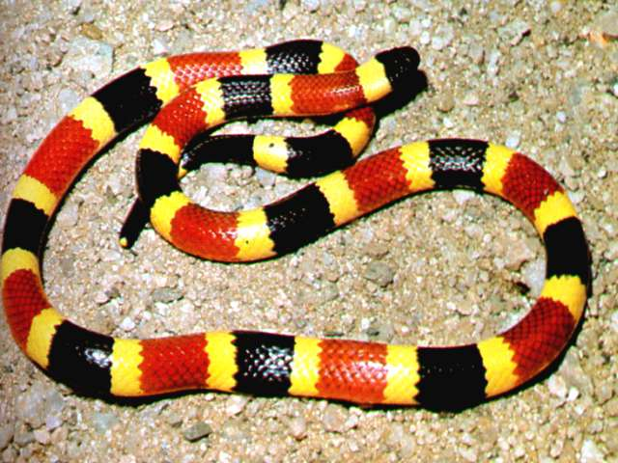
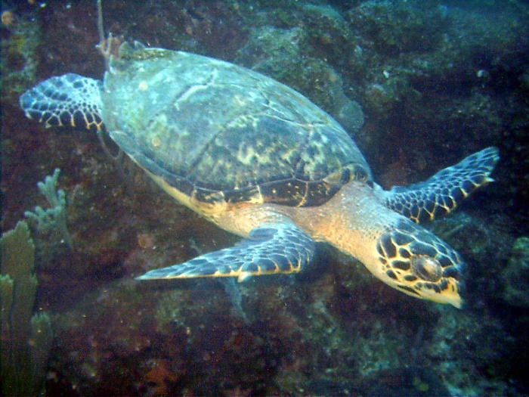
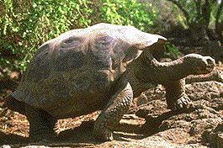
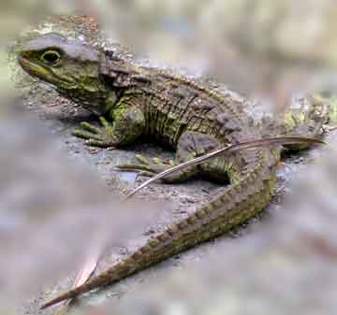
Snake
Sea Turtle
turtles
lizards

Slide 13
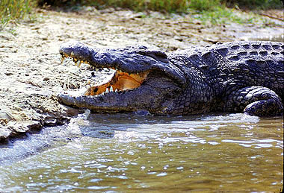
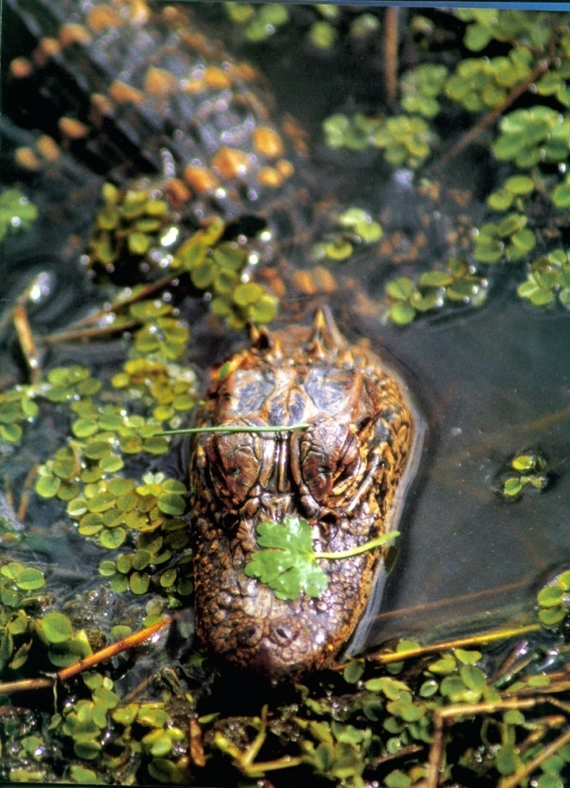
Nile Crocodile
North American Alligator

Slide 14
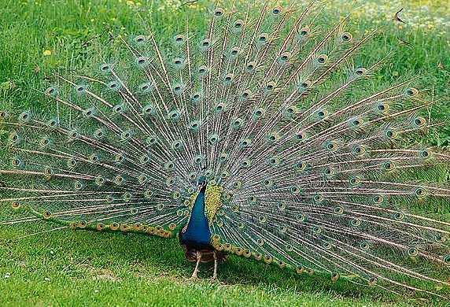
Birds – Basic Facts
Birds are vertebrate closely related to reptiles (lay eggs with waterproof shell ), but hard shells not rubbery.
Have outer covering made of feathers,
two legs used for walking, and forelimbs modified into wings
Feathers provide insulation for warmth; can generate on body heat
Endothermic
Heart 4 chambers
Beak adapted to type of food they eat
Internal fertilization but the development occurs outside – hard shelled eggs

Slide 15
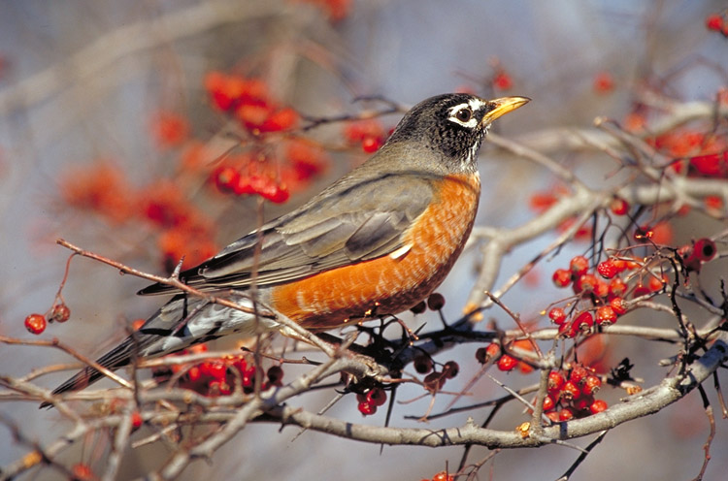
Section 31-2
Birds
have the following
adaptations to flight
Wings
Feathers
Strong chest
muscles
Efficient
respiratory
system
Efficient
circulatory
system
which are
that also
that power
that provide
that ensure
Homologous to
front limbs in other
vertebrates
Provide
warmth
Upward and
downward wing
strokes
One-way flow
of O₂-rich air
O₂ distribution
to body tissues

Slide 16
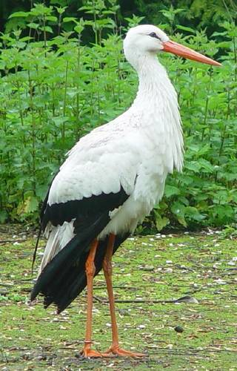
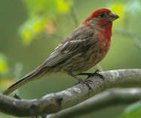
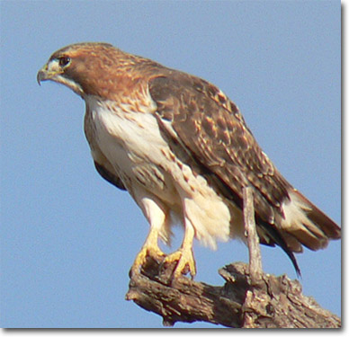
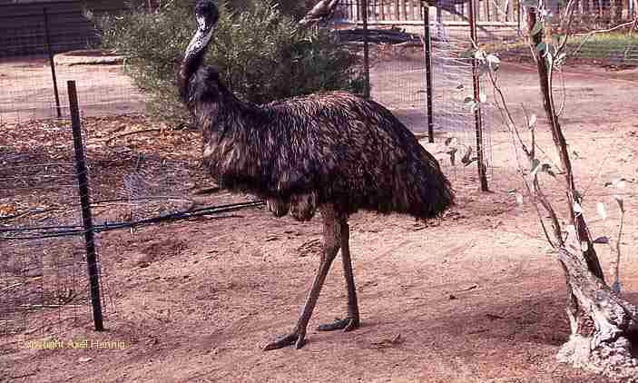
Purple Finch
Stork
Red-Tailed Hawk
Ostriches

Slide 17
Mammals – human belong it
Basic characteristics
  Vertebrate with Hair or fur – even marine like whales have some . For heat insulation
  Have placenta
  Mammary glands – produce milk to nourish young
  Four chambered heart
  Have a Diaphragm
  Warm- blooded … endothermic
  Different types of teath (incisors , canines, premolers and molars )
  Cerebral hemoispheres are very well developed

Slide 18
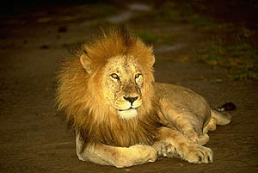
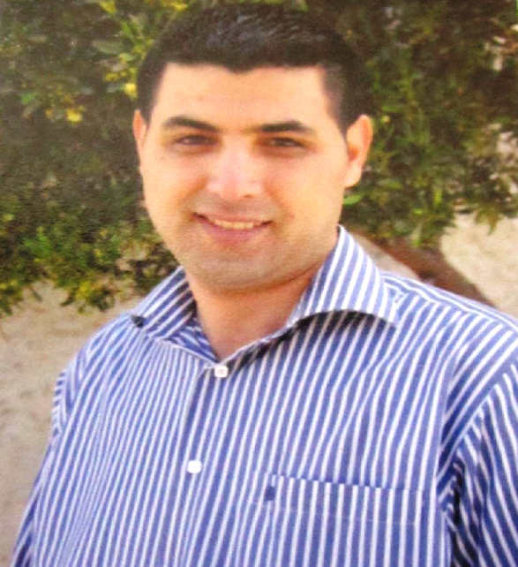
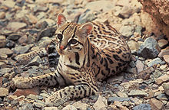
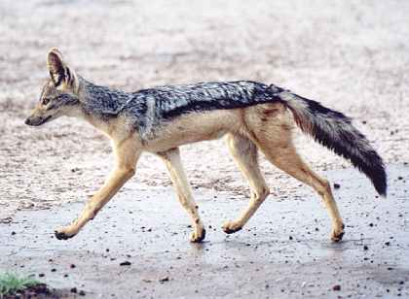
Mammals
lion
Human
ocelot
jackal

Slide 19
